Slide 1
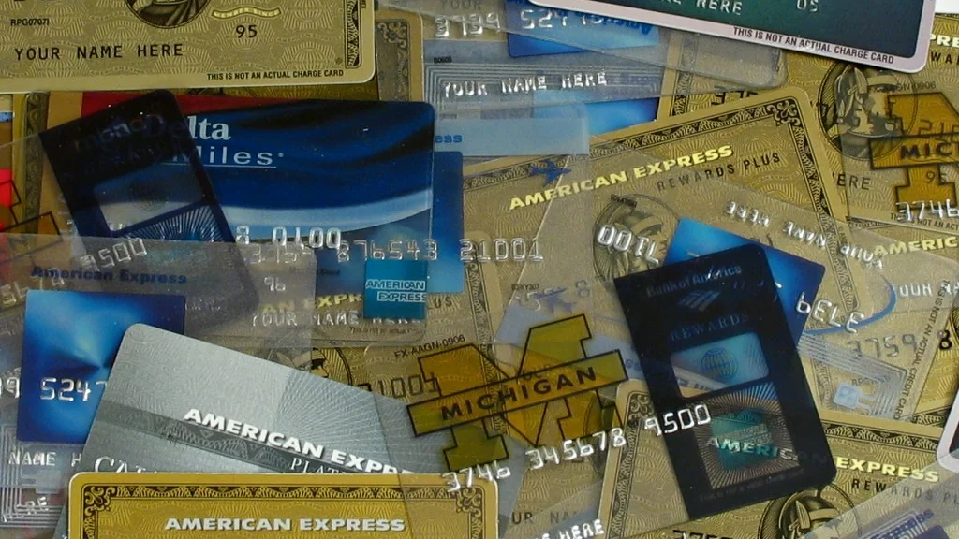
Classifying credit card default
Hani Haider and Nina Fiore

Slide 2

the problem
83% of Americans own at least one credit card
Almost 50% of households carry balances over month to month; 60% for over a year
Over 14 million people in the U.S. have at least $10,000 in credit card debt
The average credit card debt of U.S. families is $6,270
The average American has 3.8 credit cards

Slide 3

the data
American Express Credit Card Default Dataset
190 variables
11 categorical variables
179 numerical variables
Over 900,000 users
Delinquency
Spending
Payment
Balance
Risk

Slide 4
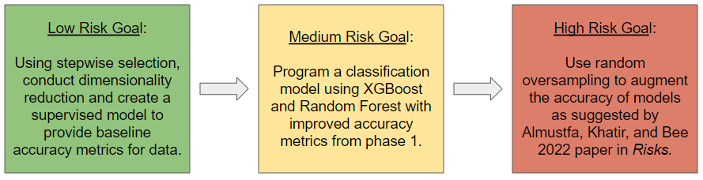

the approach
Goal: maximize the accuracy of a classification model using XGBoost and Random Forest, with a target of 85% on the test data.
Metrics: Accuracy, Specificity, Sensitivity as calculated from Confusion Matrix:

Slide 5
the references
Almustfa, A., Khatir, H. and M. Bee [24 August 2022]. “Machine Learning Models and Data-Balancing Techniques for Credit Scoring: What is the Best Combination?” Risks, vol. 10: pp. 169. [Online] available: https://doi.org/10.3390/risks10090169/.
American Express – Default Prediction. Kaggle. [Online] available: https://www.kaggle.com/competitions/amex-default-prediction/.
Flynn, Jack. “30+ Credit Card Statistics [2023]: Credit Card Debt, Fraud, Usage, And Ownership Facts” [20 December 2022]. Zippia. [Online] available: https://www.zippia.com/advice/credit-card-statistics/.
Hopkins, Christopher. “Credit Card Balances Surge – and are likely to get worse” Chattanooga Times Free Press. [Online] available: https://www.timesfreepress.com/news/2022/dec/01/credit-card-balances-surge-tfp/.
Wolf, Zachary. “The US has reached its debt limit. What comes next is predictable” [19 January 2023]. CNN. [Online] available: https://www.cnn.com/2023/01/18/politics/us-debt-ceiling-what-matters/index.html/.

